Slide 1
Research Project
Presented By; Devin Young
CTEC 226
3/17/2023

Slide 2
Introduction
The purpose of this presentation is to inform the audience about modern database management systems (DBMS), what they are typically used for, and security issues that arise and can be addressed within them.

Slide 3
DBMS Description
A database management system is a a collection of programs that manages the database structure and controls access to the data stored in the database (Coronel and Morris, 2019, pg. 6)
A database is a shared, integrated computer structure that stores a collection of end-user data and metadata (Coronel and Morris, 2019, pg. 5)

Slide 4
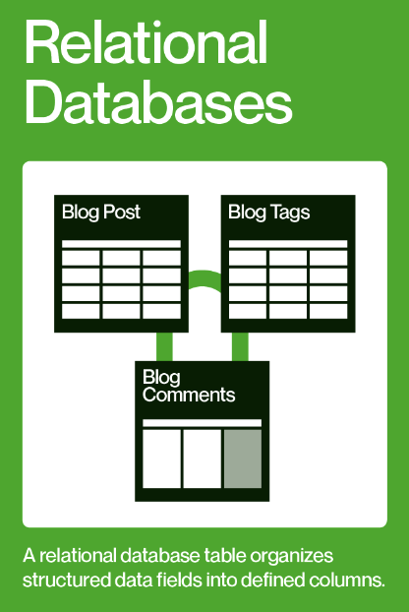
Types and Structures of DBMS
Relational Database
Database that consists of a collection of tables that can be joined through a common field; each table contains information on a specific subject, stored in the same file (Access Module 1: Databases and Database Objects: An Intro)
(The Upwork Team, 2021)

Slide 5
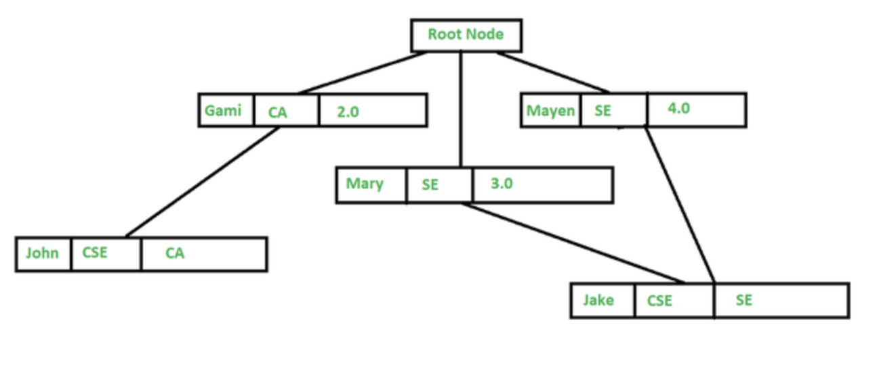
Types and Structures of DBMS
Hierarchical
In this, the data is organized into a tree-like structure where each record consists of one parent record and many children (Hierarchical Model in DBMS, 2021)
Hierarchical models are also commonly used as physical models because of the inherent hierarchical structure of the disk storage system like tracks, cylinders, etc. There are various examples such as Information Management System (IMS) by IBM, NOMAD by NCSS, etc (Hierarchical Model in DBMS, 2021)
(Hierarchical Model in DBMS, 2021)

Slide 6
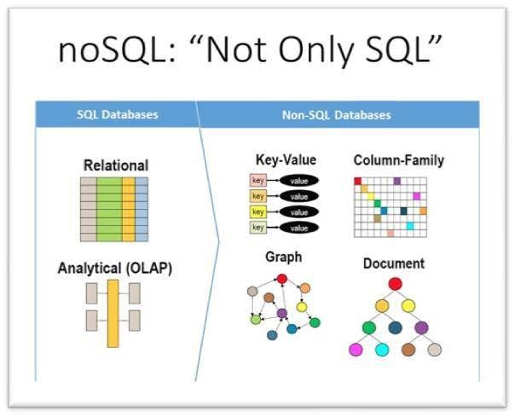
Types and Structures of DBMS
No SQL Databases
NoSQL is a non-relational database, meaning it allows different structures than a SQL database (not rows and columns) and more flexibility to use a format that best fits the data (Anderson & Nicholson, 2022).
NoSQL is a good choice when there are large amounts of (or ever-changing) data sets or when working with flexible data models or needs that don't fit into a relational model ((Anderson & Nicholson, 2022).
(Williams, 2021)

Slide 7
Types and Structures of DBMS
Object-Based
In Object-Based Databases, each entity is treated as an object and represented in a table. Similar objects are classified into classes and subclasses and the relationship between two objects is maintained using the concept of inverse reference (Object-Based Databases, 2022)
Best Suited for:
Complex data and a wider variety of data types than MySQL data types
It’s easy to save and recover data quickly.
Seamless integration with object-oriented programming languages (Object-Based Databases, 2022).

Slide 8
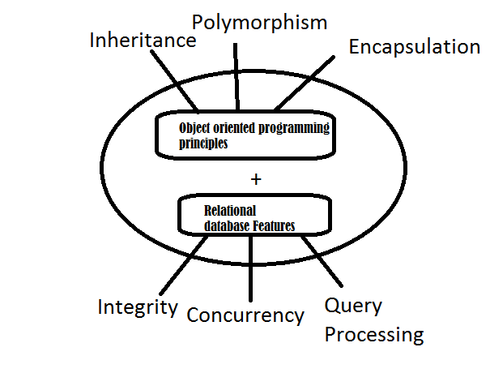
Types and Structures of DBMS
Object-Oriented
An object-oriented database management system is a hybrid application that uses a combination of object-oriented and relational database principles to process data (What is an Object-Oriented Database?, 2023).
It also follow the fundamental principles of object-oriented programming (What is an Object-Oriented Database?, 2023).
(What is an Object-Oriented Database?, 2023).
)

Slide 9
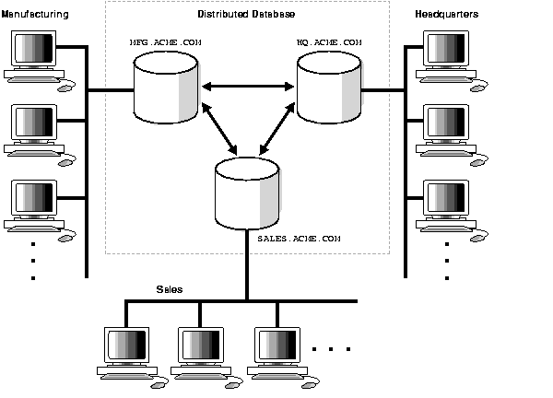
Types and Structures of DBMS
Distributed
A distributed database is basically a database that is not limited to one system, it is spread over different sites, i.e, on multiple computers or over a network of computers (Distributed Database System, 2023).
A distributed database system is located on various sites that don’t share physical components (Distributed Database System, 2023).
This may be required when a particular database needs to be accessed by various users globally (Distributed Database System, 2023).
Applications of a Distributed Database:
It is used in Corporate Management Information System.
It is used in multimedia applications.
Used in Military’s control system, Hotel chains etc.
It is also used in manufacturing control system.
(Distributed Database System, 2023).
(28 Distributed Database Concepts, 2023).

Slide 10
Database Security
Refers to DBMS features and other related measures that comply with the organization’s security requirements
Databases can be secured by:
changing the default system password and default installation paths,
applying the latest patches,
securing installation folders with proper access rights
Making sure that only required devices are running
Setting up auditing logs
Setting up session logging
Requiring session encryption
Having great authorization management

Slide 11
Concerns & Measures (Inference)
Inference Attacks
Attacks that occur when a user is able to make inferences about data that they are not authorized to access based on queries that they are authorized to execute (Database Security, 2023).
Inference Attack Prevention
One way that we can guard against inference attacks is by preventing the access of aggregate information about a set of tuples when the size of that set is too small or too large (Database Security, 2023).
Inference Attack Prevention (cont)
We can further defend against inference attacks by removing identifying information from databases, such as anonymization, de-identification, and generalization (Database Security, 2023).

Slide 12
Concerns & Measures (Aggregation)
Aggregation
Aggregation refers to the process by which entities are combined to form a single meaningful entity (Mbaabu, 2021).
The specific entities are combined because they do not make sense on their own (Mbaabu, 2021).
Aggregation (cont)
The resulting entity makes sense because it enables the system to function well (Mbaabu, 2021).
Reasons for Aggregation Application within a DBMS
DBMS consists of many entities that are not significant enough to provide meaningful information (Mbaabu, 2021).

Slide 13
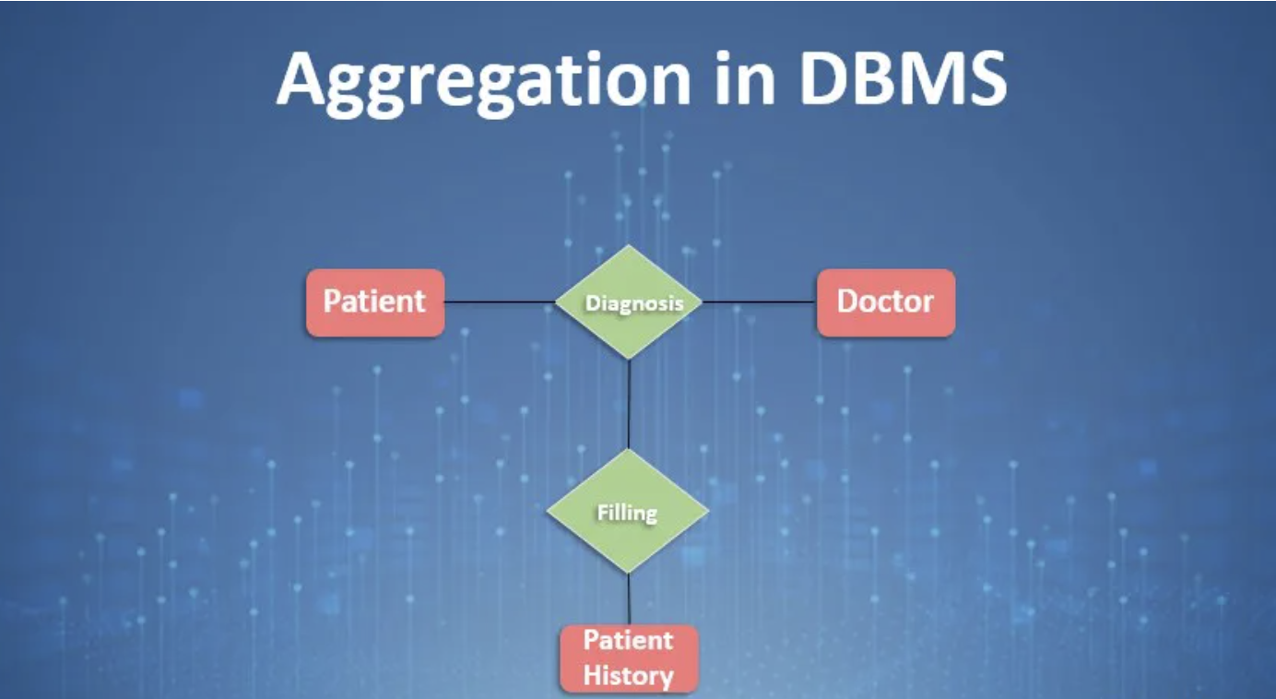
Concerns & Measures (Aggregation Part II)
Reasons for Aggregation Application within a DBMS (cont)
DBMS consists of a single entity that should be used for multiple operations (Mbaabu, 2021)
The entity-model relationship cannot be applied to certain entities within DBMS (Mbaabu, 2021)
(Pedamkar, 2022)

Slide 14
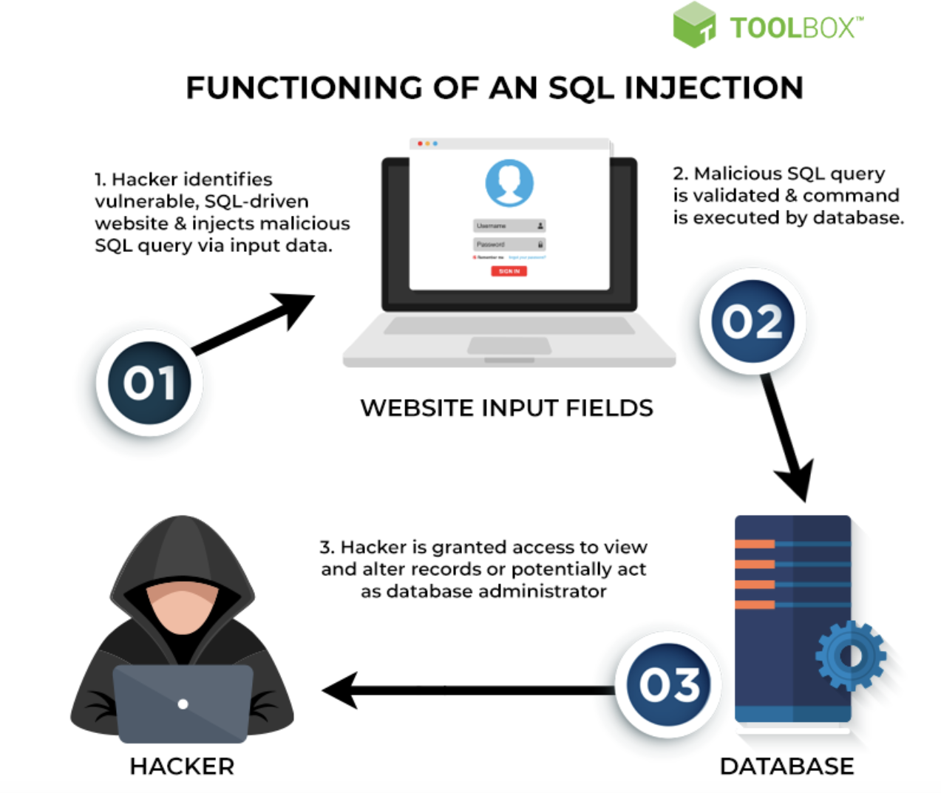
Concerns & Measures (Injection)
Injection
SQL injection attacks are a type of injection attack, in which SQL commands are injected into data-plane input in order to affect the execution of predefined SQL commands (SQL Injection, 2023).
Successful Injection Attack can:
Read sensitive data from the database
Modify database data
Execute administration operations on the database
(SQL Injection, 2023)
SQL Injection Prevention
Use of Prepared Statements (with Parameterized Queries)
Use of Properly Constructed Stored Procedures
Allow-list Input Validation
Escaping All User Supplied Input
(SQL Injection Prevention Cheat Sheet, 2023)
(BasuMallick, 2022)

Slide 15
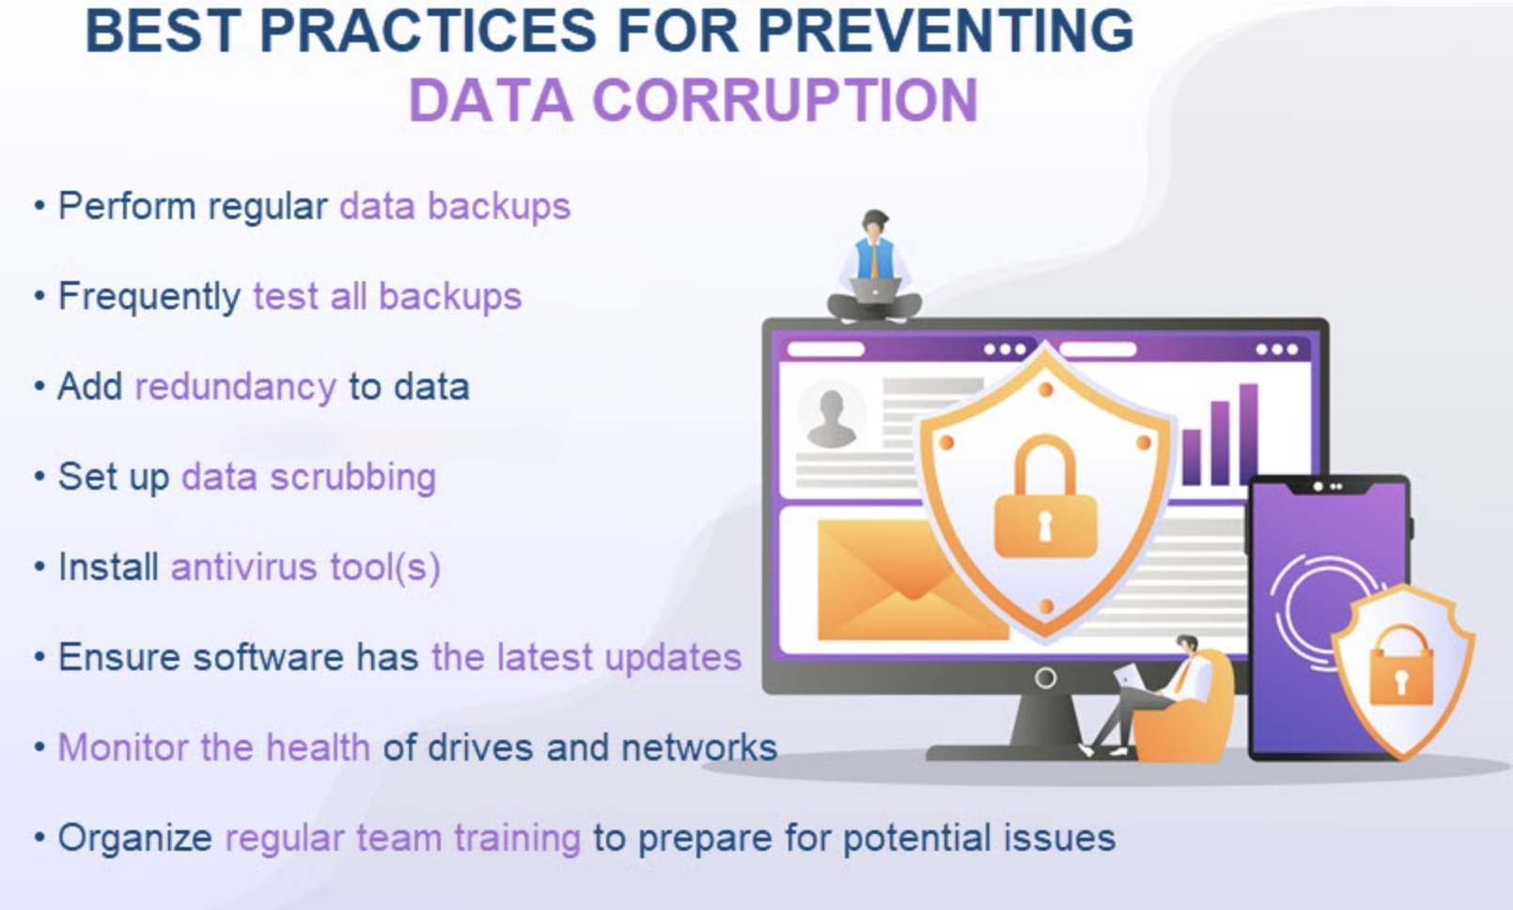
Concerns & Measures (Data Corruption)
Data Corruption
Data corruption refers to any unwanted change that happens to a file during storage, transmission, or processing (Velimirovic, 2022)
(Velimirovic, 2022)

Slide 16
Concerns & Measures (Unauthorized Access)
Unauthorized Access
Unauthorized access refers to access that another person or computer gains, without being given that access (How to Protect Your Data from Unauthorized Access, 2020)
Prevention of Unauthorized Access
Keep current on all security patches
Implement the principle of least privilege
Track and manage your risks
(How to Protect Your Data from Unauthorized Access, 2020)

Slide 17
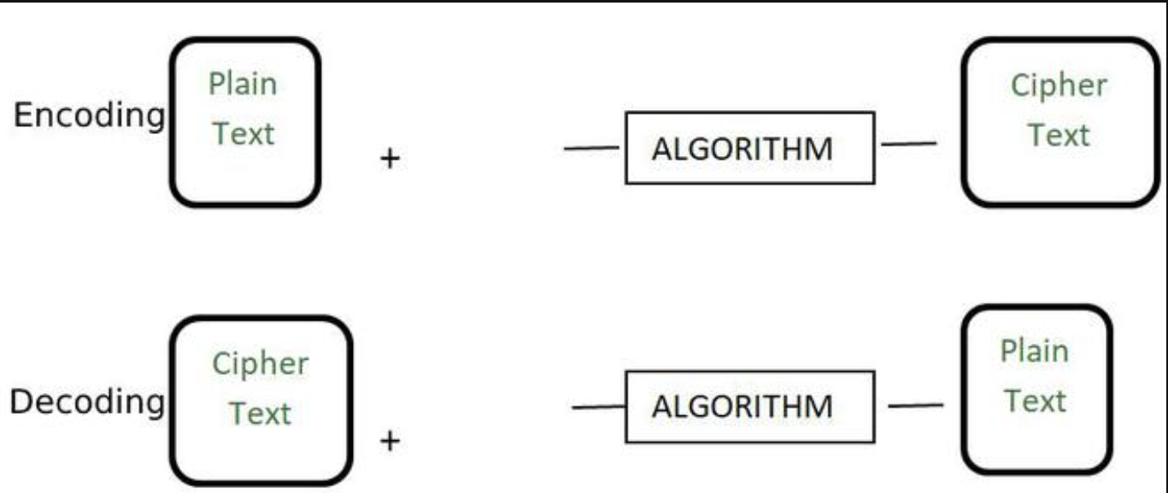
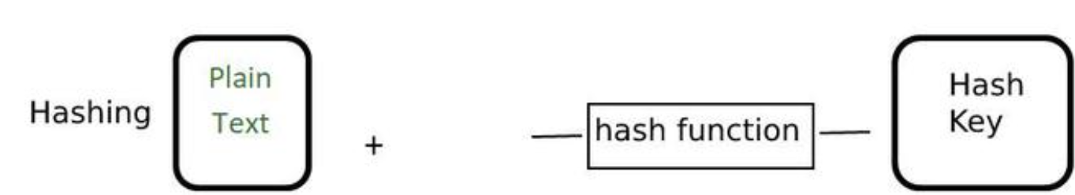
Concerns & Measures (Encryption / Hashing)
Encryption
The process of converting a normal readable message known as plaintext into a garbage message or not readable message known as Ciphertext (Difference between Hashing and Encryption, 2021)
Hashing
It is a process to convert information to a shorter fixed value known as the key that is used to represent the original information (Difference between Hashing and Encryption, 2021)
(Difference between Hashing and Encryption, 2021)
(Difference between Hashing and Encryption, 2021)

Slide 18
Concerns & Measures (Database Access Controls)
What is Database Access Control?
Database access control is a method of allowing access to company’s sensitive data only to those database users) who are allowed to access such data and to restrict access to unauthorized persons (What is Access Control in Database Security?, 2023)
DAC
Discretionary access control is a method of limiting access to resources (such as data sets) based on the identity of users or groups to which the users belong (Discretionary Access Control, 2023)
MAC
Mandatory access control is a method of limiting access to resources based on the sensitivity of the information that the resource contains and the authorization of the user to access information with that level of sensitivity (Mandatory Access Control, 2023)
RBAC
Role-based access control allows the creation of roles for system administration and the delegation of administrative tasks across a set of trusted system users (Role-Based Access Control, 2023)

Slide 19
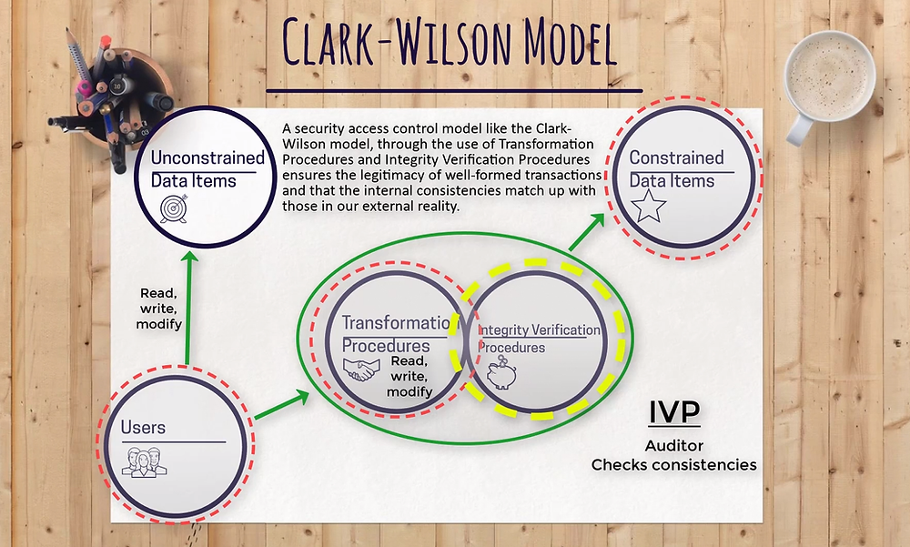
Concerns & Measures (Database Access Controls)
Clark-Wilson Model
The Clark-Wilson security model is based on preserving information integrity against the malicious attempt of tampering data (Lakhani, 2018)
Clark Wilson Model (cont)
The security model maintains that only authorized users should make and be allowed to change the data, unauthorized users should not be able to make any changes, and the system should maintain internal and external data consistency (Lakhani, 2018)
(Ahmed, 2018)

Slide 20
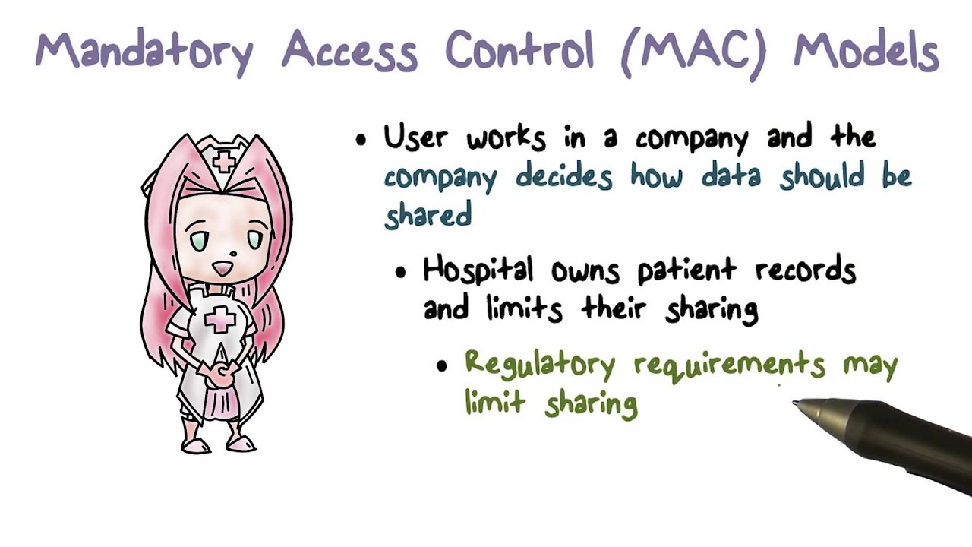
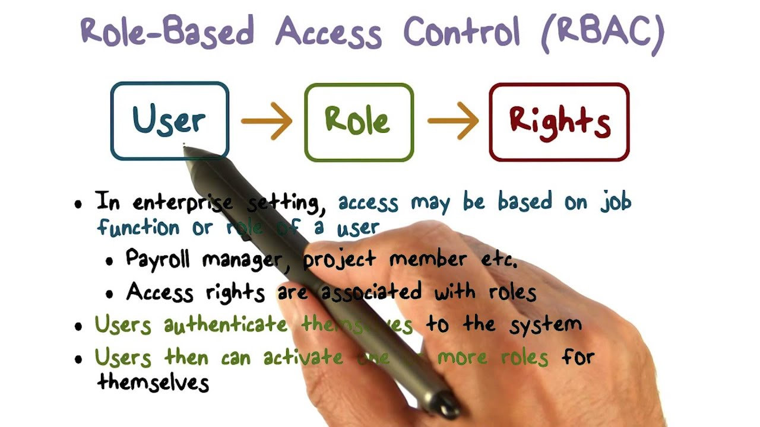
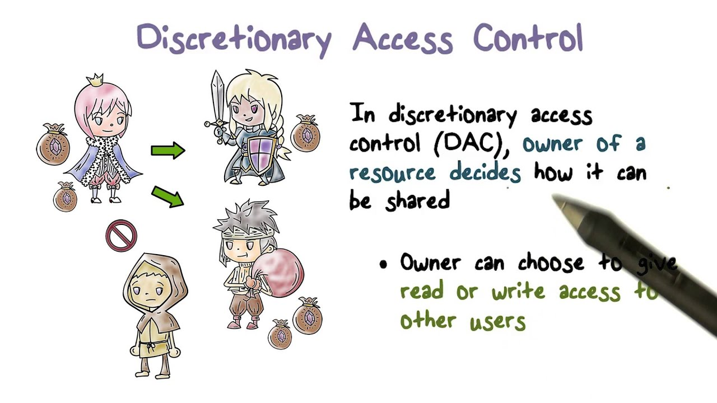
Concerns & Measures (Database Access Controls)
(Discretionary Access Control, 2016)
(Mandatory Access Control, 2016)
(Role-Based Access Control, 2016)

Slide 21
Thank You!

Slide 22
References
(Access Module 1: Databases and Database Objects: An Intro)
Ahmed, L. (2018, July 22). The Clark-Wilson Model. Study Notes and Theory. Retrieved March 17, 2023, from https://www.studynotesandtheory.com/single-post/the-clark-wilson-model
Anderson, B., &amp; Nicholson, B. (2022, June 12). SQL vs. NoSQL databases: What's the difference? IBM. Retrieved March 15, 2023, from https://www.ibm.com/cloud/blog/sql-vs-nosql

Slide 23
References
BasuMallick, C. (2022, August 3). What is an SQL injection? Meaning, Cheatsheet, Examples, and Prevention Best Practices for 2022. Spiceworks. Retrieved March 17, 2023, from https://www.spiceworks.com/it-security/application-security/articles/what-is-sql-injection/
Coronel, C., Morris, S. (2019). Chapter 1: Database Systems. In Database systems: Design, implementation, and management (13th ed.). essay, Cengage Learning.
Database Security. Information Security. (n.d.). Retrieved March 16, 2023, from https://www.omscs-notes.com/information-security/database-security/#inference-attacks-on-databases-part-1
Discretionary Access Control (DAC). IBM. (n.d.). Retrieved March 17, 2023, from https://www.ibm.com/docs/en/zos/2.1.0?topic=environment-discretionary-access-control-dac

Slide 24
References
GeeksforGeeks. (2021, January 22). Difference between Hashing and Encryption. GeeksforGeeks. Retrieved March 17, 2023, from https://www.geeksforgeeks.org/difference-between-hashing-and-encryption/
GeeksforGeeks. (2023, March 4). Distributed Database System. GeeksforGeeks. Retrieved March 15, 2023, from https://www.geeksforgeeks.org/distributed-database-system/
GeeksforGeeks. (2021, July 7). Hierarchical Model in DBMS. GeeksforGeeks. Retrieved March 14, 2023, from https://www.geeksforgeeks.org/hierarchical-model-in-dbms/
GeeksforGeeks. (2022, February 23). Object-based databases. GeeksforGeeks. Retrieved March 15, 2023, from https://www.geeksforgeeks.org/object-based-databases/
How to Protect Your Data from Unauthorized Access. Cypress Data Defense RSS. (2020, June 15). Retrieved March 17, 2023, from https://www.cypressdatadefense.com/blog/unauthorized-data-access/

Slide 25
References
Lakhani, A. (2018, November 7). Clark-Wilson Security Model. Dr. Chaos - Dark Security and Total Chaos Blog . Retrieved March 17, 2023, from https://www.drchaos.com/post/clark-wilson-security-model
Mandatory Access Control (MAC). Mandatory access control (MAC). (n.d.). Retrieved March 17, 2023, from https://www.ibm.com/docs/en/zos/2.4.0?topic=environment-mandatory-access-control-mac
Mbaabu, O. (2021, January 8). Aggregation in Database Management Systems (DBMS). Section. Retrieved March 16, 2023, from https://www.section.io/engineering-education/aggregation-in-dbms/#aggregation-in-dbms
Pedamkar, P. (2022, September 27). Aggregation in DBMS: Comprehensive Guide to Aggregation in DBMS. EDUCBA. Retrieved March 17, 2023, from https://www.educba.com/aggregation-in-dbms/

Slide 26
References
Role-Based Access Control. (n.d.). Retrieved March 17, 2023, from https://www.ibm.com/docs/en/aix/7.2?topic=system-role-based-access-control
SQL Injection. OWASP Foundation. (n.d.). Retrieved March 17, 2023, from https://owasp.org/www-community/attacks/SQL_Injection
SQL Injection Prevention Cheat Sheet. SQL Injection Prevention - OWASP Cheat Sheet Series. (n.d.). Retrieved March 17, 2023, from https://cheatsheetseries.owasp.org/cheatsheets/SQL_Injection_Prevention_Cheat_Sheet.html
The Upwork Team. (2021, July 26). NoSQL vs. SQL: Important Differences &amp; Which One Is Best for Your Project. upwork. Retrieved March 14, 2023, from https://www.upwork.com/resources/nosql-vs-sql

Slide 27
References
Udacity. (2016, June 6). Discretionary Access Control. YouTube. Retrieved March 17, 2023, from https://www.youtube.com/watch?v=UNRnSaXajC4
Udacity. (2016, June 6). Mandatory Access Control Models. YouTube. Retrieved March 17, 2023, from https://www.youtube.com/watch?v=mNN-fEboRAA
Udacity. (2016, June 6). Role-Based Access Control. YouTube. Retrieved March 17, 2023, from https://www.youtube.com/watch?v=C4NP8Eon3cA
Velimirovic, A. (2022, July 14). What is Data Corruption and Can You Prevent It? phoenixNAP Blog. Retrieved March 17, 2023, from https://phoenixnap.com/blog/data-corruption

Slide 28
References
What is Access Control in Database Security? DataSunrise Data &amp; Database Security. (n.d.). Retrieved March 17, 2023, from https://www.datasunrise.com/professional-info/what-is-access-control/
Williams, A. (2021, May 13). The NoSQL know-it-all compendium. KDnuggets. Retrieved March 15, 2023, from https://www.kdnuggets.com/2021/05/nosql-know-it-all-compendium.html
28 Distributed Database Concepts. Distributed Database Concepts. (n.d.). Retrieved March 15, 2023, from https://docs.oracle.com/cd/B10501_01/server.920/a96521/ds_concepts.htm

